Slide 1
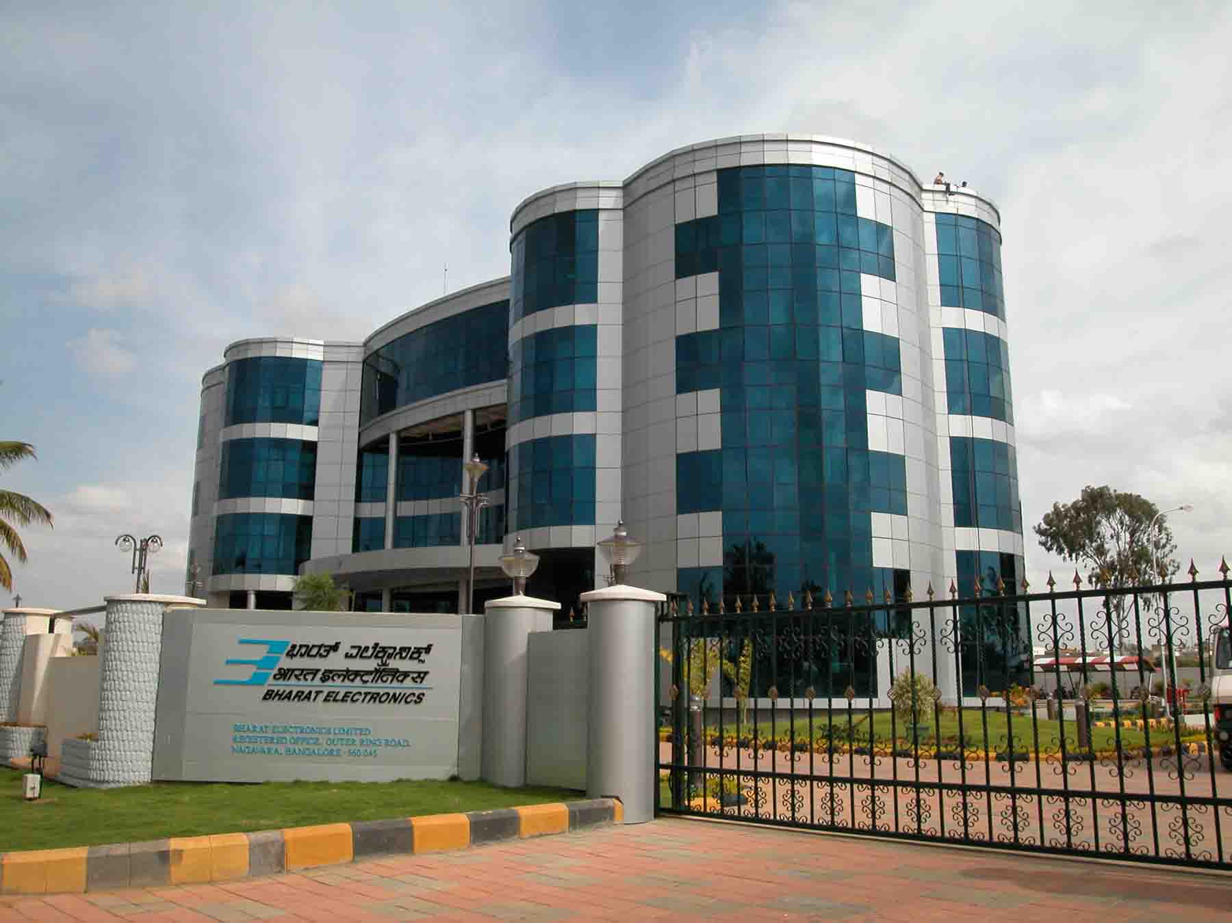
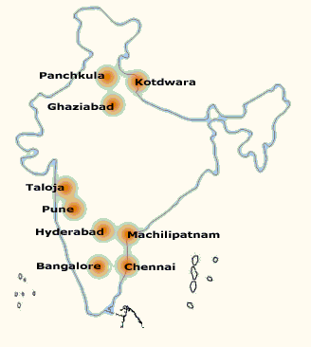
Bharat Electronics
www.bel-india.in

Slide 2
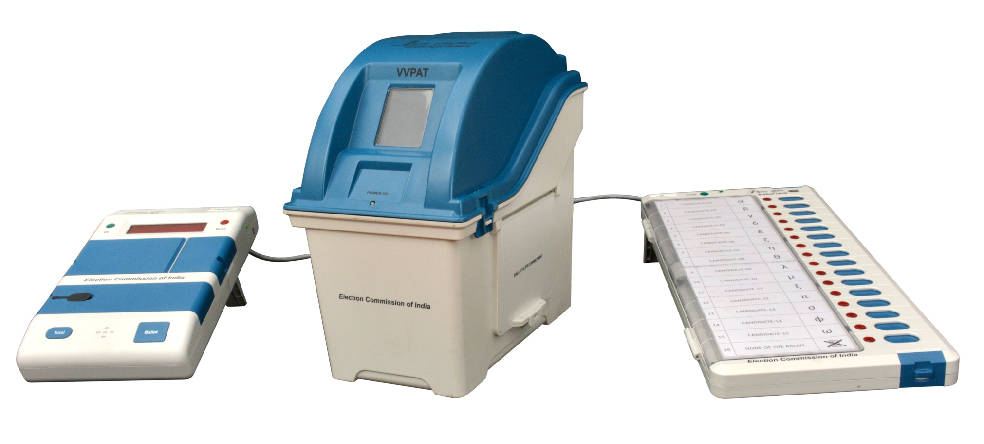
VVPAT
Counting of
Electronic Voting Machine (EVM) with VVPAT

Slide 3
VVPAT
Procedure at the Counting Place

Slide 4
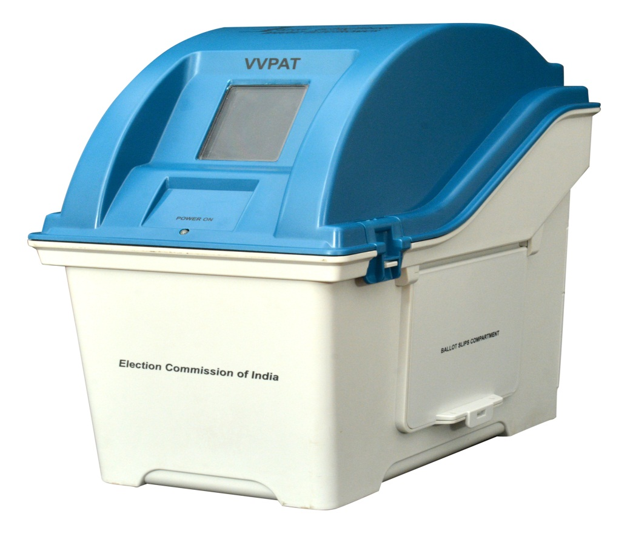
VVPAT Counting
Keep the Ballot Slips in Tray and Count slips to verify with Result of Control Unit.T
Cut the seal and Open Ballot Slips Compartment
Thanks

